Slide 1


Slide 2
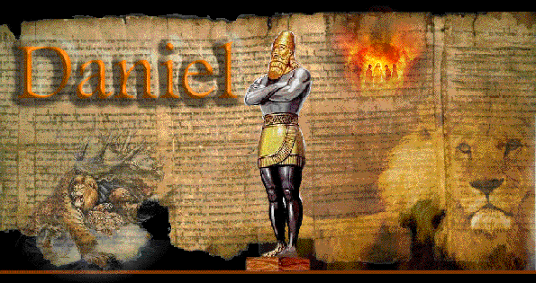
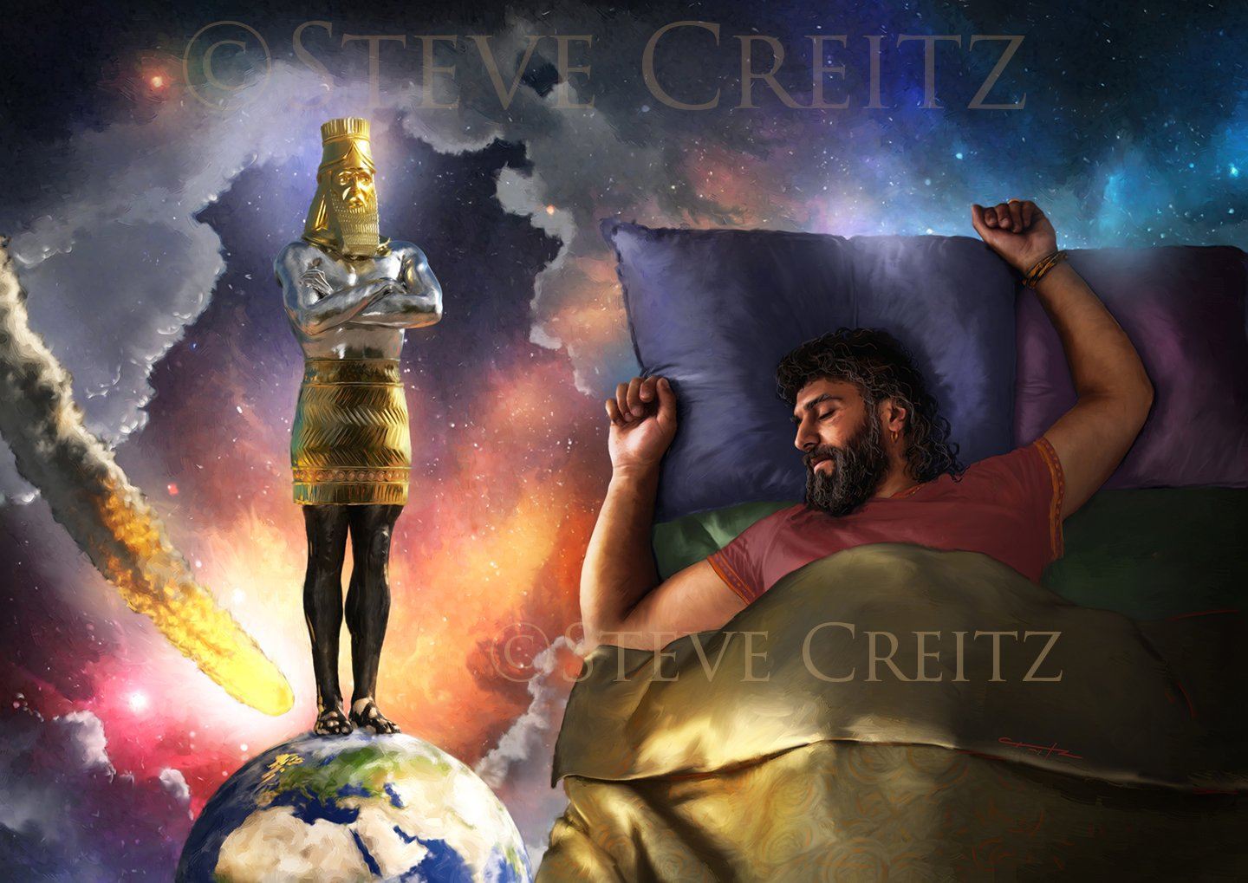

Babylon
Medo-Persian
Greece
Roman
Divided Nations

Slide 3
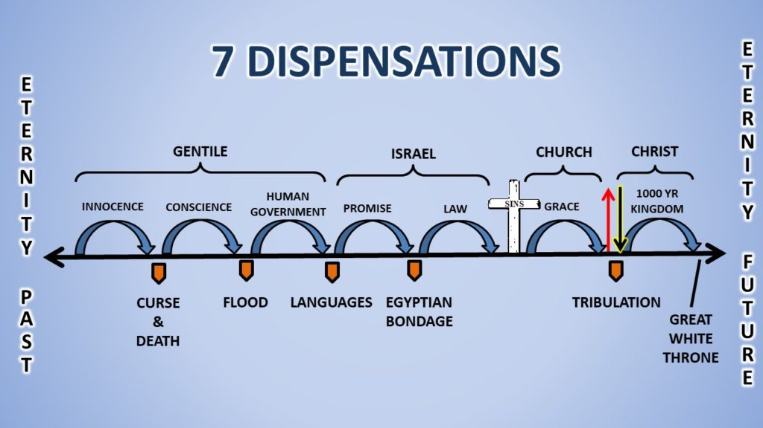
Church Age:

Slide 4
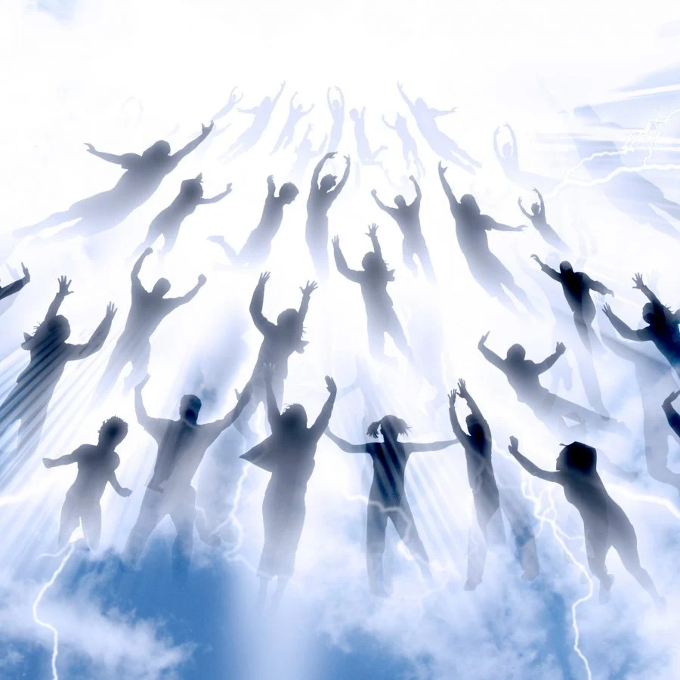
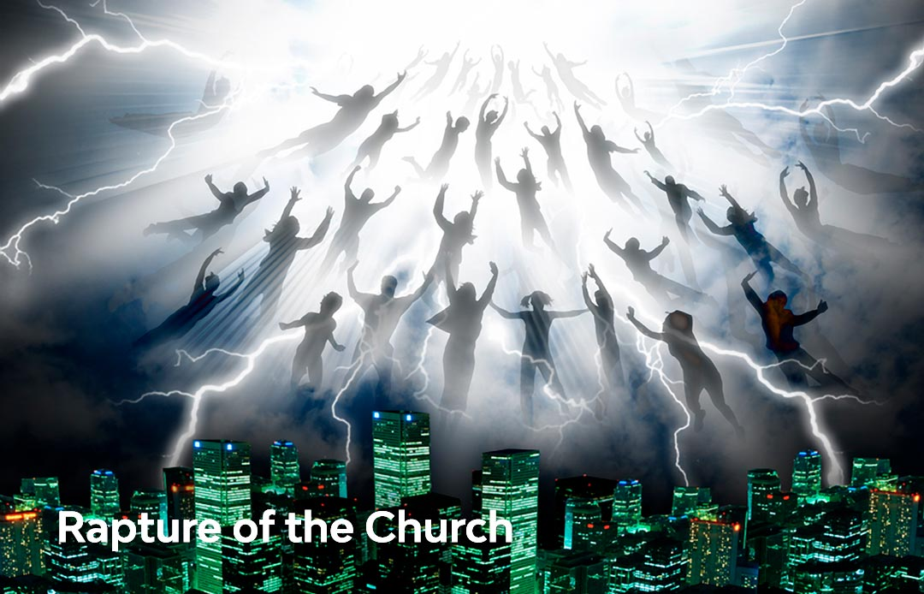
Rapture:

Slide 5
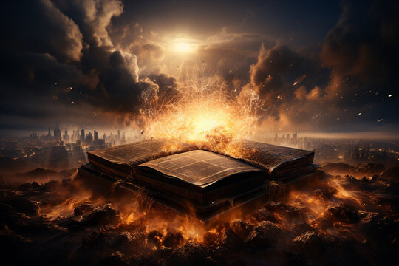

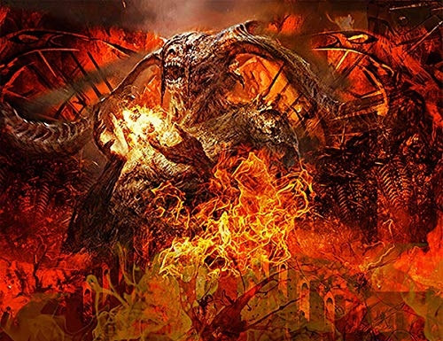
Tribulation:

Slide 6
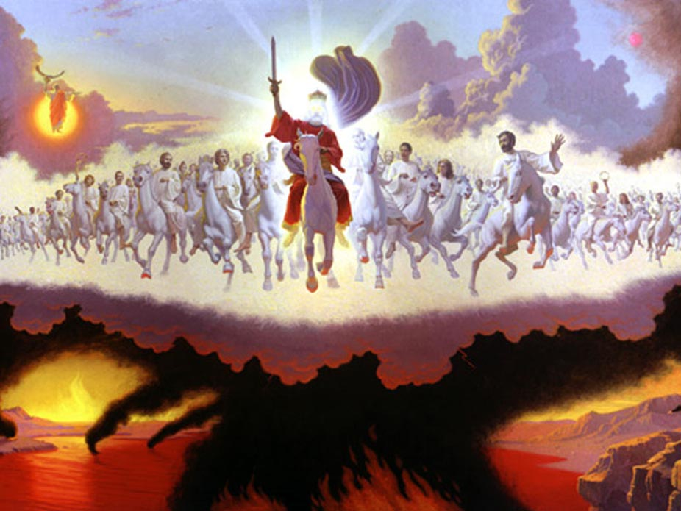
Second Coming (Second Advent)

Slide 7


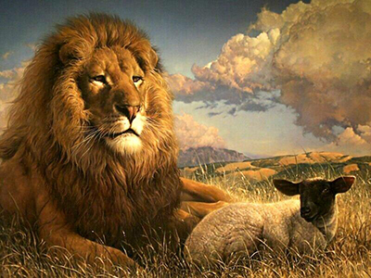
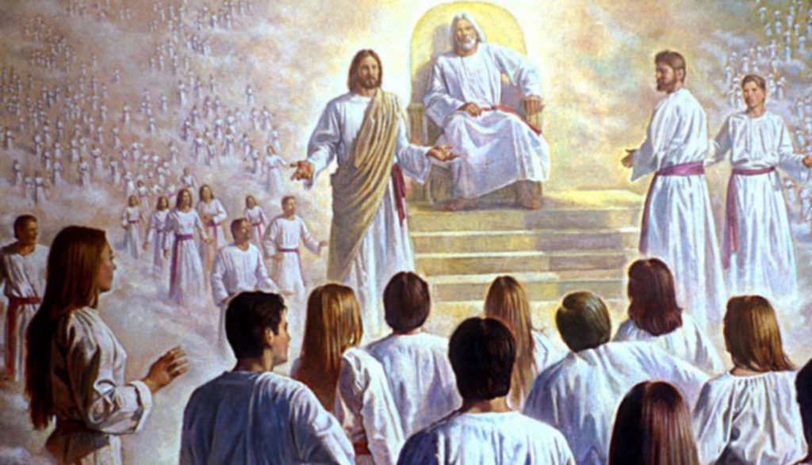
Millenium

Slide 8
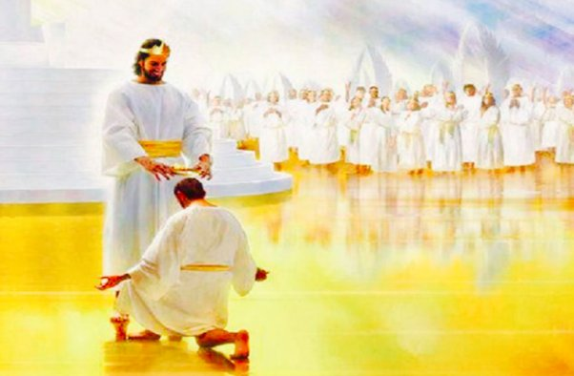
Bema Judgement Seat of Christ

Slide 9
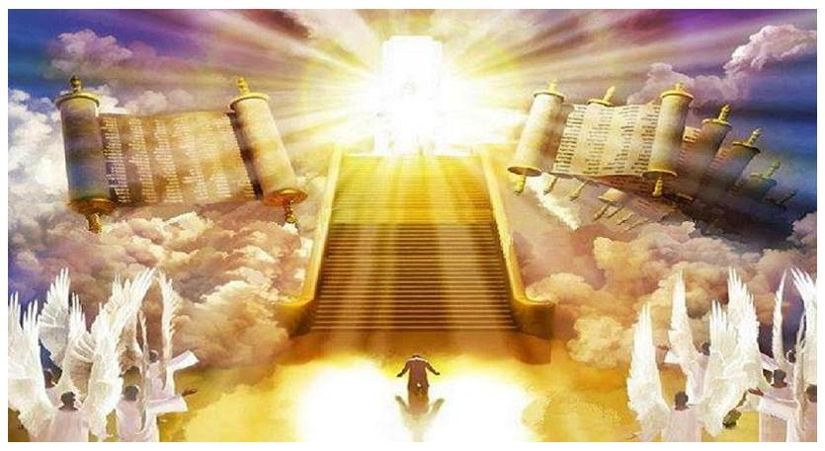
White Throne Judgement

Slide 10
WHEN WILL THE CHURCH BE RAPTURED?

Slide 11
pre-trib
mid-trib
post-trib
Tribulation
Revelation 3:10 “Since you have kept my command to endure patiently, I will also keep you from the hour of trial that is going to come upon the whole world to test those who live on the earth.”

Slide 12
When will Jesus return?

Slide 13

pre-millennial
Post-millenial
MILLENIAL
KINGDOM
TRIBULATION

Slide 14

Pre-tribulation, pre-millennial view
Post-tribulation, pre-millennial view
Post-millennial view
A-millennial view

Slide 15

The Preterist view
The Futurists view
The Historicists view

Slide 16
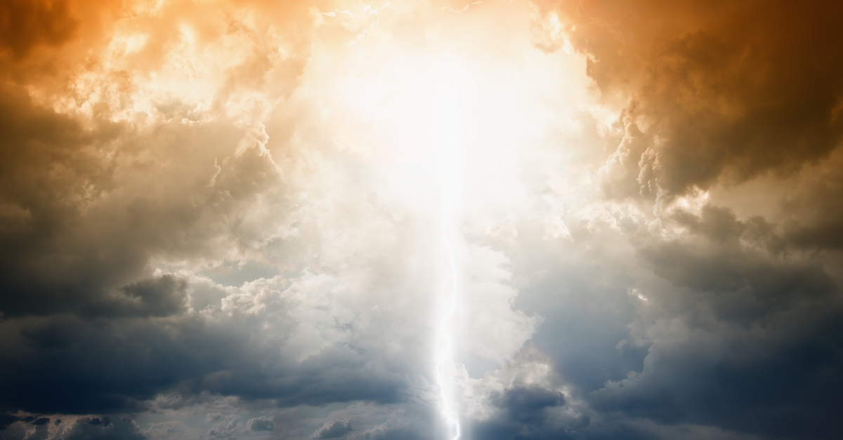

Pre-tribulation
Pre-millennial Futurists

Slide 17
Two basic ways scripture is interpreted in this Book
1. Metaphorically (Spiritually)
2. Literally

Slide 18




Symbolism:
  Numbers
  Colors
  Persons
  Animals
  Objects
  Places

