Slide 1


Slide 2


Slide 3


Pre-tribulation
Pre-millennial Futurists

Slide 4
Two basic ways scripture is interpreted in this Book
1. Metaphorically (Spiritually)
2. Literally

Slide 5




Symbolism:
  Numbers
  Colors
  Persons
  Animals
  Objects
  Places

Slide 6

BIG IDEA: We Must Interpret Scripture Properly
2 Timothy 2:15
General Principles of Biblical Interpretation
intention
  Historical
  Grammatical
  Cultural
  Literal
2. Context
3. Literally
4. Interpret
5. Distinguished
6. Distinctions
7. type.

Slide 7
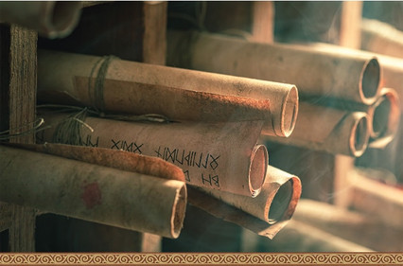
Types of Biblical Literature
1. Narrative Literature: historical
2. Law: law principles
3. Wisdom Literature: not
4. Poetry: figurative
5. Gospel Literature
  Matthew – Jewish audience
  Mark – Roman audience
  Luke – Greek audience
  John – Universal audience (Gentiles)
6. Parables: Stories
7. Acts: History human divine
8. Epistles: believers
9. Revelation (Apocalyptic): symbolic

