Slide 1
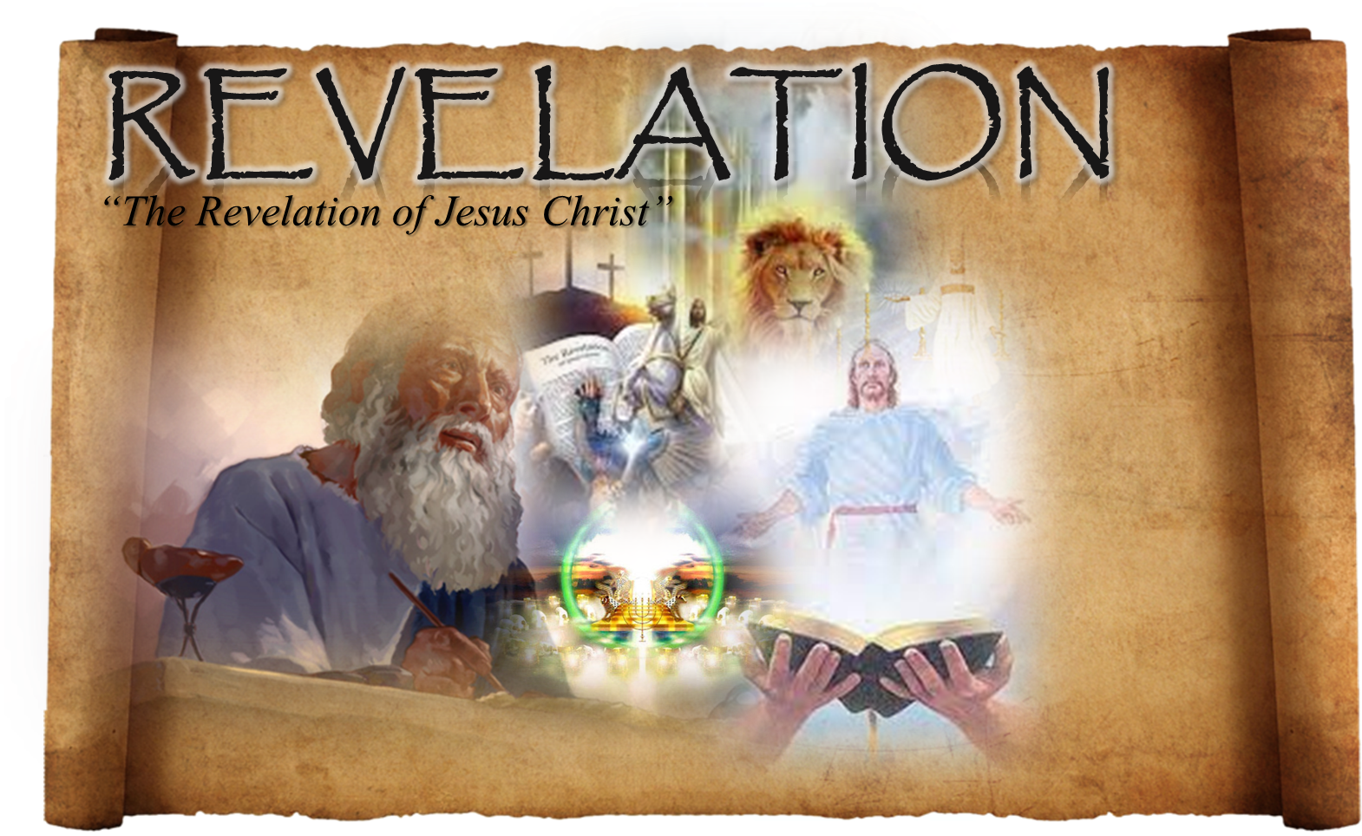

Slide 2


Slide 3
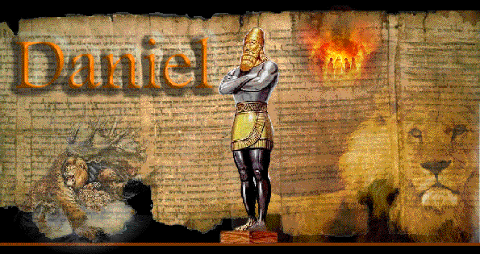
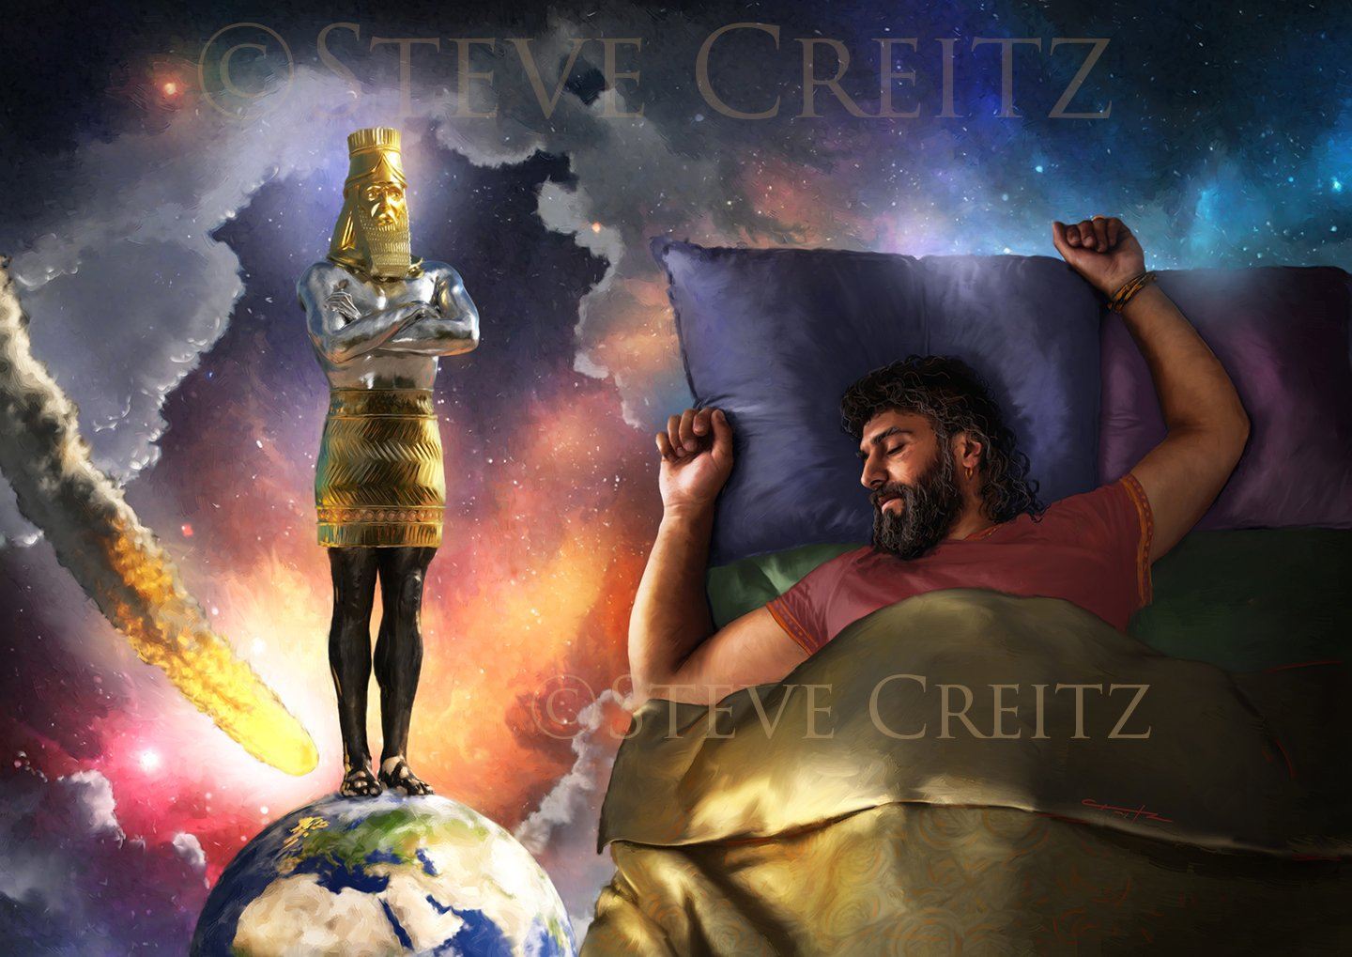

Babylon
Medo-Persian
Greece
Roman
Divided Nations

Slide 4
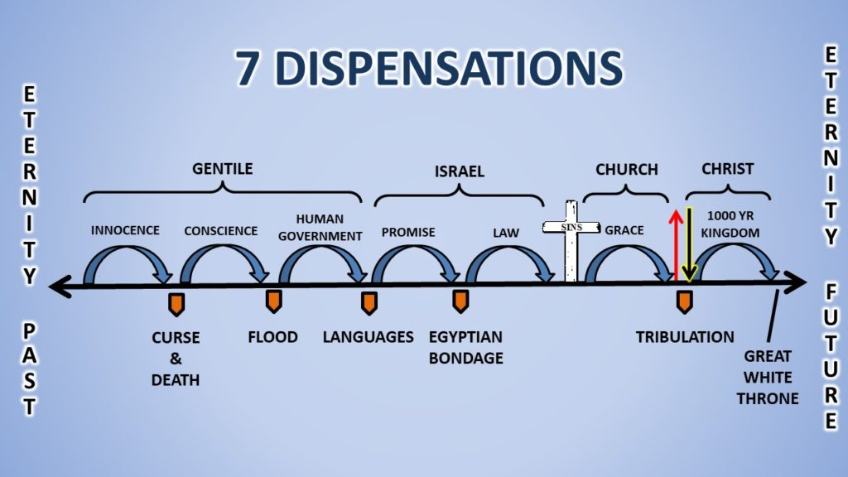
Church Age:

Slide 5
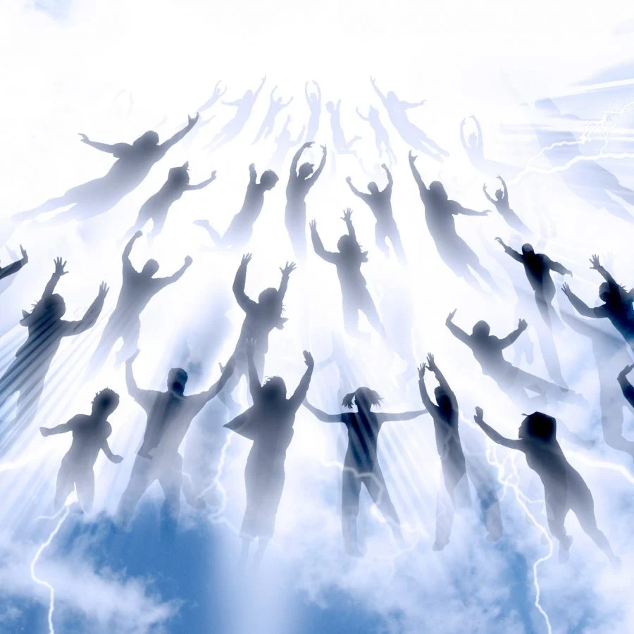
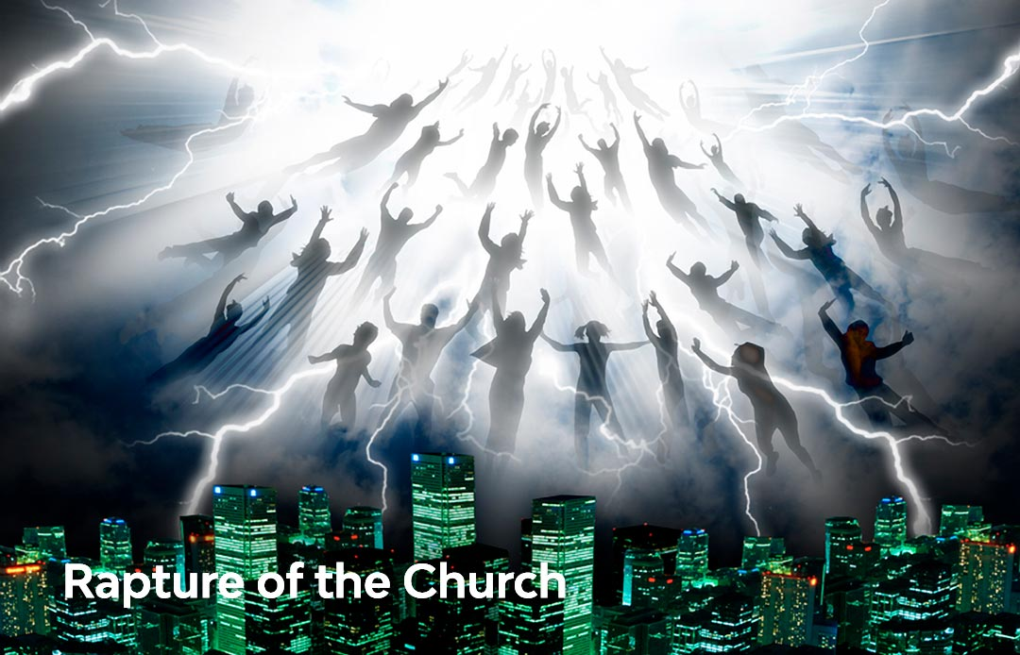
Rapture:

Slide 6
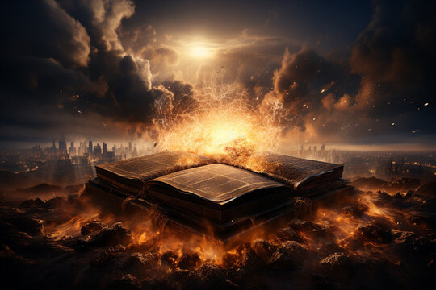
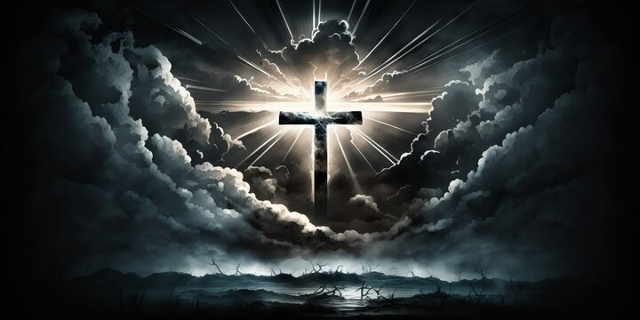
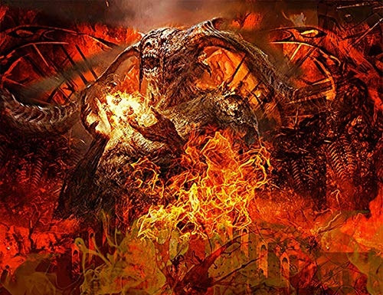
Tribulation:

Slide 7
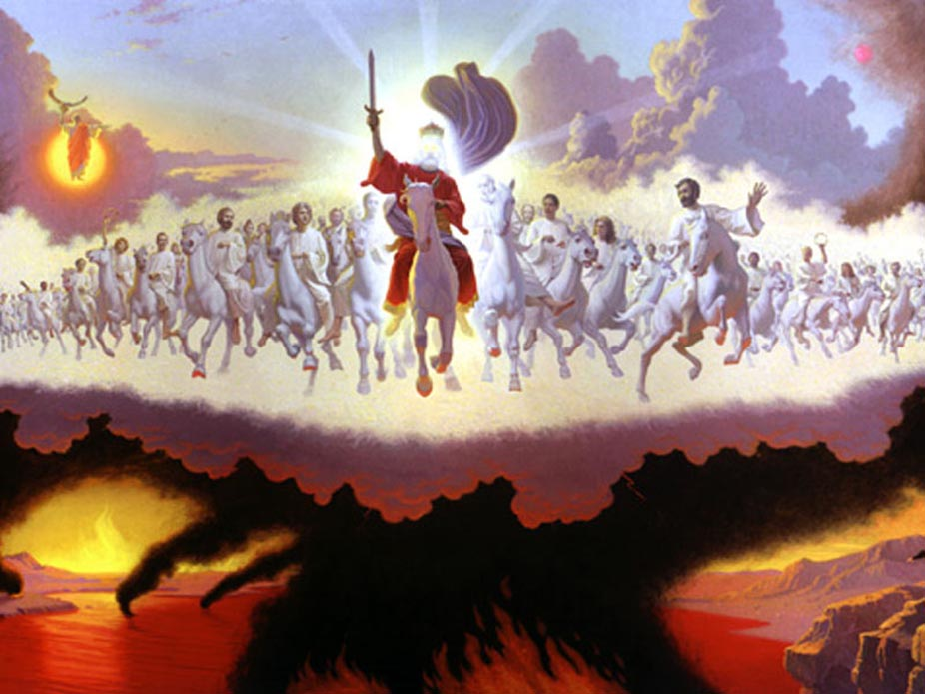
Second Coming (Second Advent)

Slide 8


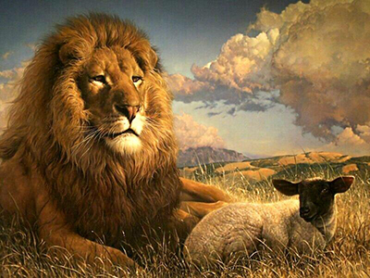
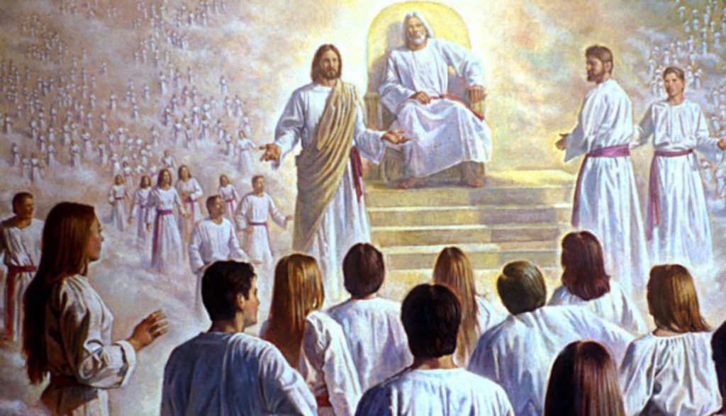
Millenium

Slide 9
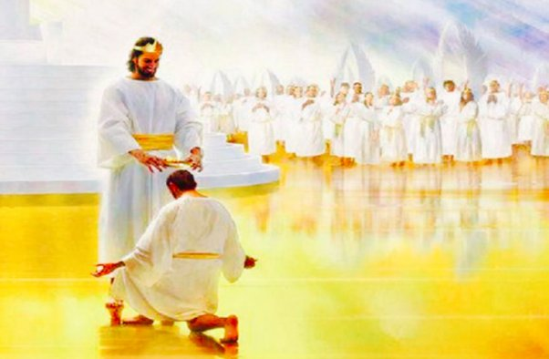
Bema Judgement Seat of Christ

Slide 10
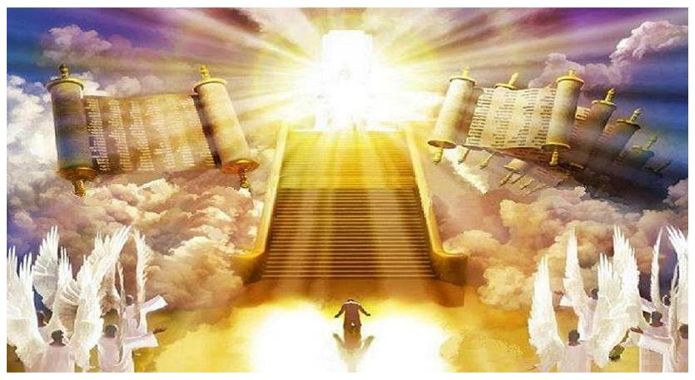
White Throne Judgement

Slide 11
WHEN WILL THE CHURCH BE RAPTURED?

Slide 12
pre-trib
mid-trib
post-trib
Tribulation
Revelation 3:10 “Since you have kept my command to endure patiently, I will also keep you from the hour of trial that is going to come upon the whole world to test those who live on the earth.”

Slide 13
When will Jesus return?

Slide 14

pre-millennial
Post-millenial
MILLENIAL
KINGDOM
TRIBULATION

Slide 15

Pre-tribulation, pre-millennial view
Post-tribulation, pre-millennial view
Post-millennial view
A-millennial view

Slide 16

The Preterist view
The Futurists view
The Historicists view

Slide 17
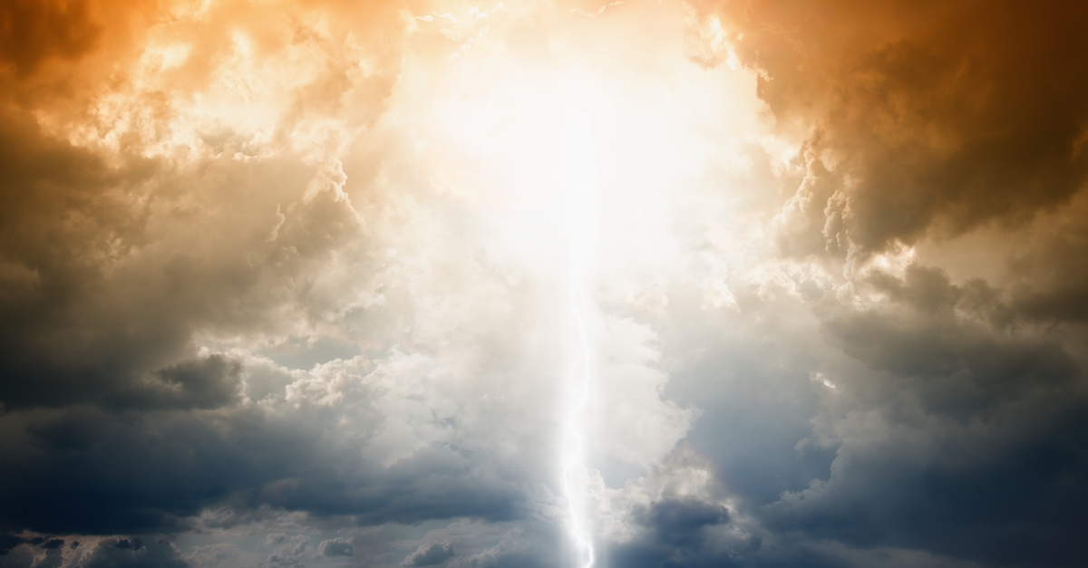

Pre-tribulation
Pre-millennial Futurists

Slide 18
Two basic ways scripture is interpreted in this Book
1. Metaphorically (Spiritually)
2. Literally

Slide 19




Symbolism:
  Numbers
  Colors
  Persons
  Animals
  Objects
  Places

Slide 20
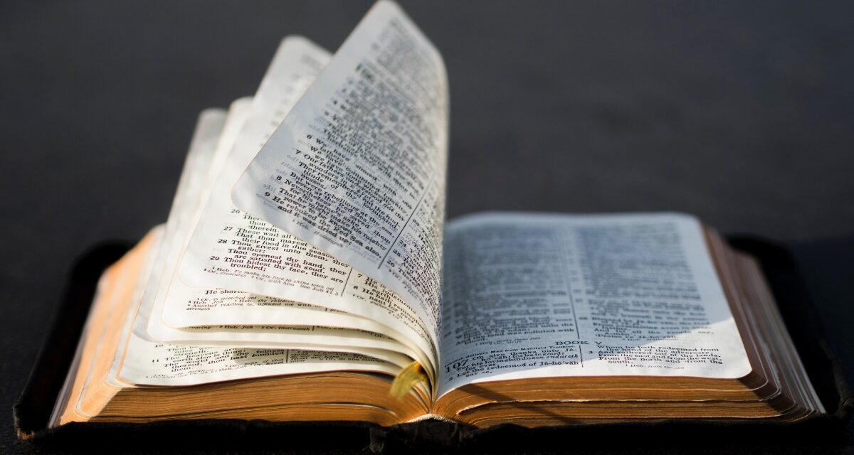
BIG IDEA: We Must Interpret Scripture Properly
2 Timothy 2:15
General Principles of Biblical Interpretation
intention
  Historical
  Grammatical
  Cultural
  Literal
2. Context
3. Literally
4. Interpret
5. Distinguished
6. Distinctions
7. type.

Slide 21
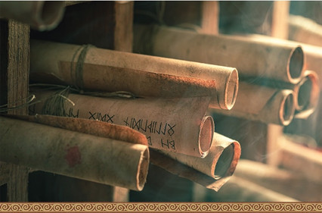
Types of Biblical Literature
1. Narrative Literature: historical
2. Law: law principles
3. Wisdom Literature: not
4. Poetry: figurative
5. Gospel Literature
  Matthew – Jewish audience
  Mark – Roman audience
  Luke – Greek audience
  John – Universal audience (Gentiles)
6. Parables: Stories
7. Acts: History human divine
8. Epistles: believers
9. Revelation (Apocalyptic): symbolic

Slide 22
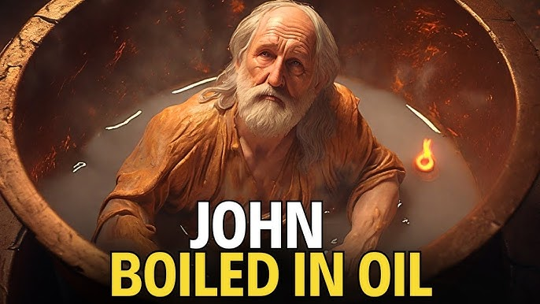

Slide 23

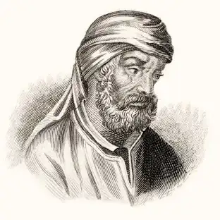
(Chapter 36.) “……How happy is its church, on which apostles poured forth all their doctrine along with their blood! Where Peter endures a passion like his Lord's!
(Chapter 36.) “……How happy is its church, on which apostles poured forth all their doctrine along with their blood! Where Peter endures a passion like his Lord's! Where Paul wins his crown in a death like John's where the Apostle John was first plunged, unhurt, into boiling oil, and thence remitted to his island-exile!”
Tertullian
“The Prescription Against Heretics”
This short treatise was composed by Tertullian (Quintus Septimius Florens Tertullianus; 155 - 240 AD) on how Christians should deal with heresy and heretical arguments, mostly from pagans. He argued that the apostles transmitted the truth down to their approved successors, and that essentially no heresy is new.

Slide 24
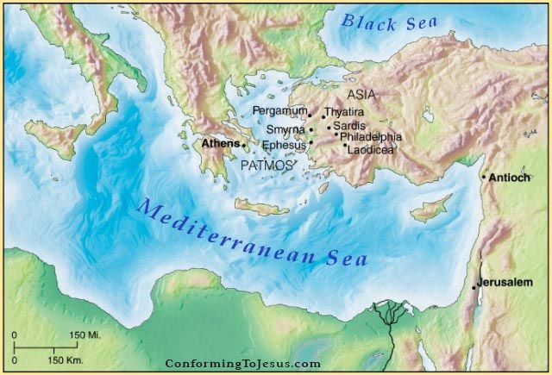

Slide 25
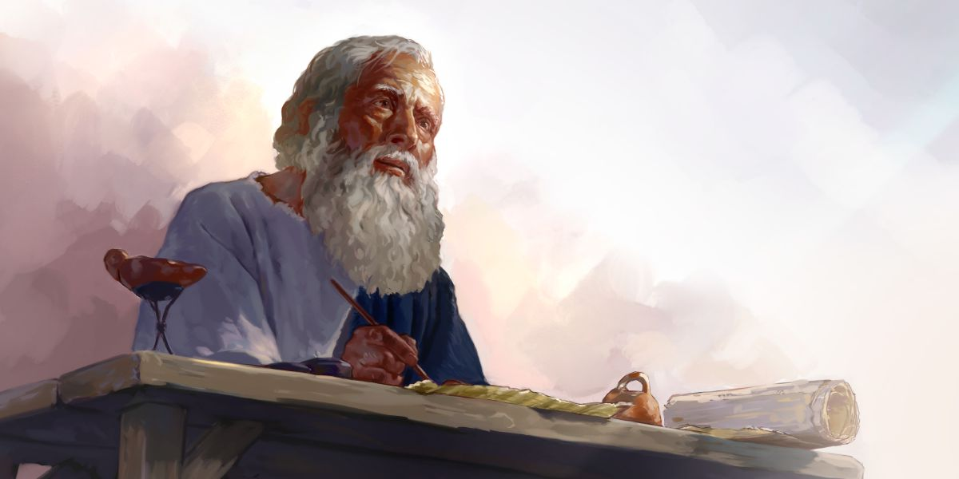
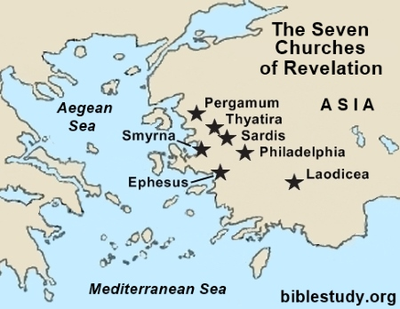
Circulatory
Letter
Patmos

Slide 26
REVELATION
1:3 ”Blessed is the one who reads aloud the words of this prophecy, and blessed are those who hear it and take to heart what is written in it, because the time is near.”
14:13 Then I heard a voice from heaven say, “Write this: Blessed are the dead who die in the Lord from now on.” “Yes,” says the Spirit, “they will rest from their labor, for their deeds will follow them.”
16:15 “Look, I come like a thief! Blessed is the one who stays awake and remains clothed, so as not to go naked and be shamefully exposed.”
19:9 Then the angel said to me, “Write this: Blessed are those who are invited to the wedding supper of the Lamb!” And he added, “These are the true words of God.”
20:6 Blessed and holy are those who share in the first resurrection. The second death has no power over them, but they will be priests of God and of Christ and will reign with him for a thousand years.
22:7 “Look, I am coming soon! Blessed is the one who keeps the words of the prophecy written in this scroll.”
22:14 “Blessed are those who wash their robes, that they may have the right to the tree of life and may go through the gates into the city.

